Slide 1
Unlocking Diversity and Reducing Compute with Trivia Augmentation
By Anna Grebenchtchikova and Chung Wong
Stanford CS224R Spring 2026

Slide 2
Modern LLM improvement suffers due to the reasoning vs diversity trade-off; and endless increasing compute requirements
Improved reasoning comes at the cost of reduced diversity
Improvement comes at ever higher compute cost
Reinforcement learning with verifiable rewards significantly improves LLM reasoning, but severely degrades output diversity
To be scalable, an LLM must go beyond learning a final correct answer to a test set, lest it collapses onto a narrow set of brittle, repetitive solutions
Post Training can deliver significant improvement to maintain diversity
As LLMs grow in size, both their training and inference costs are ever-increasing
Excessive post-training to maintain diversity would further raise the bill

Slide 3
Previous studies show (…)
Summarize key papers in 1-2 bullet points
Approach | AIME w/o | AIME w/abs | AIME best | DSR w/o | DSR w/abs | DSR best | AMC w/o | AMC w/abs | AMC best
Qwen3-1.7B | 33.75 | 36.25 ▲ | 40.00 | 20.21 | 22.14 ▲ | 32.50 | 86.41 | 78.01 ▼ | 84.53
+ DAPO | 37.92 | 34.90 ▼ | 39.79 | 21.67 | 21.88 ▲ | 33.54 | 86.41 | 81.99 ▼ | 88.44
+ RLAD | 38.04 | 42.45 ▲ | 48.33 | 23.54 | 24.84 ▲ | 35.54 | 87.25 | 88.35 ▲ | 91.72
Inconsistent across models AND benchmarks. The same intervention helps here, hurts there — and the model improves even without the hints, by amounts that swing widely. If content-rich hints are this unstable, what is the variation actually doing?

Slide 4
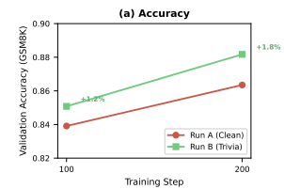
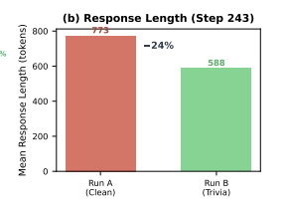
Initial result; setup of further experiments
Intial result of accuracy and lesser cost
Table overview of further experiment setup

Slide 5
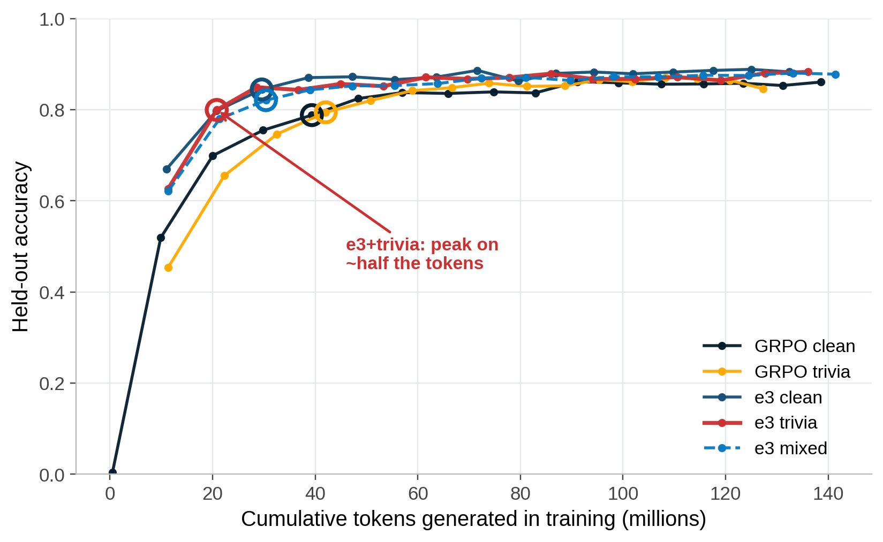
Trivia keeps accuracy and reaches peak on roughly half the tokens
What we see
In-distribution accuracy preserved
trivia tracks clean on GSM8K
Fewer truncations
16% → 14% of rollouts
~21M
tokens to peak for e3+trivia, vs ~40M for plain GRPO
Hardware-independent: a token count, not a clock.
4

Slide 6
EVERYTHING AFTER THIS IS VERY WIP IN TERMS OF SETUP

Slide 7
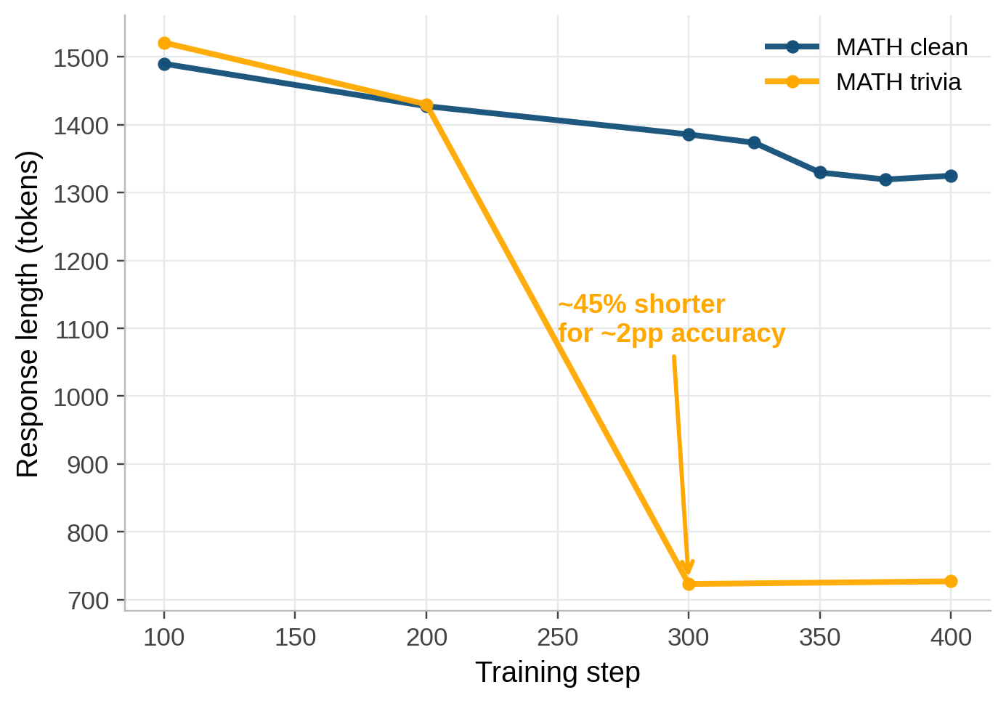
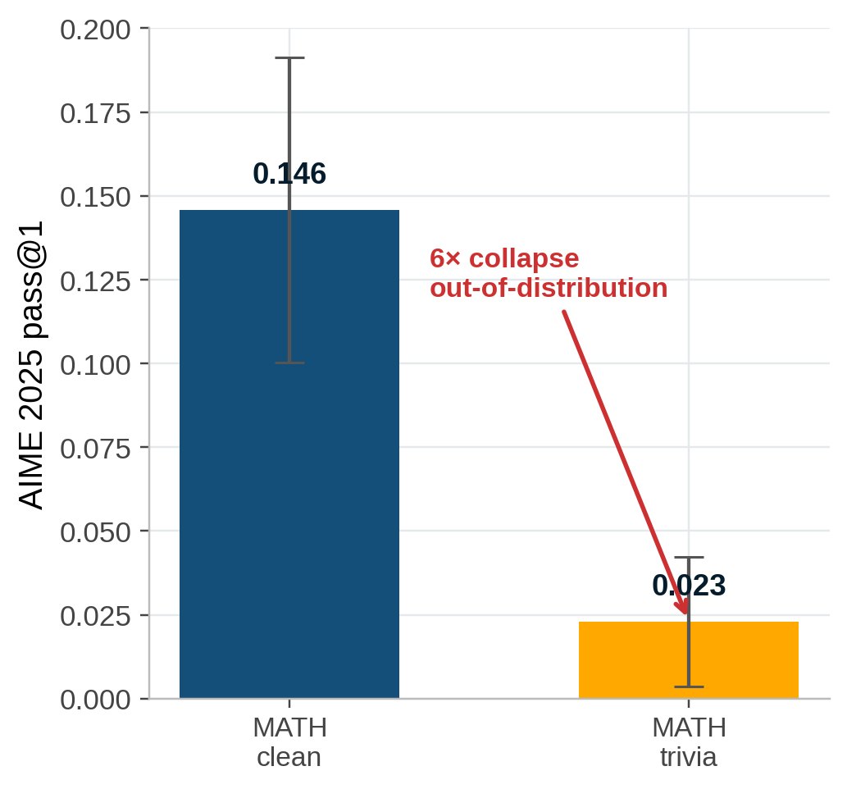
MATH: far leaner in-distribution, fragile out-of-distribution
Leaner — and cheaper
~45% shorter answers for a ~2pp accuracy cost, in-distribution.
At matched throughput, trivia’s shorter generations finished in budget; clean exceeded it and had to be stitched.
But out-of-distribution the sharpening breaks:
AIME 0.146 → 0.023 (6× collapse).
→ next: content-aware (Fibonacci) trivia
Response length (clean eval)
AIME 2025 (out-of-distribution)
5

Slide 8
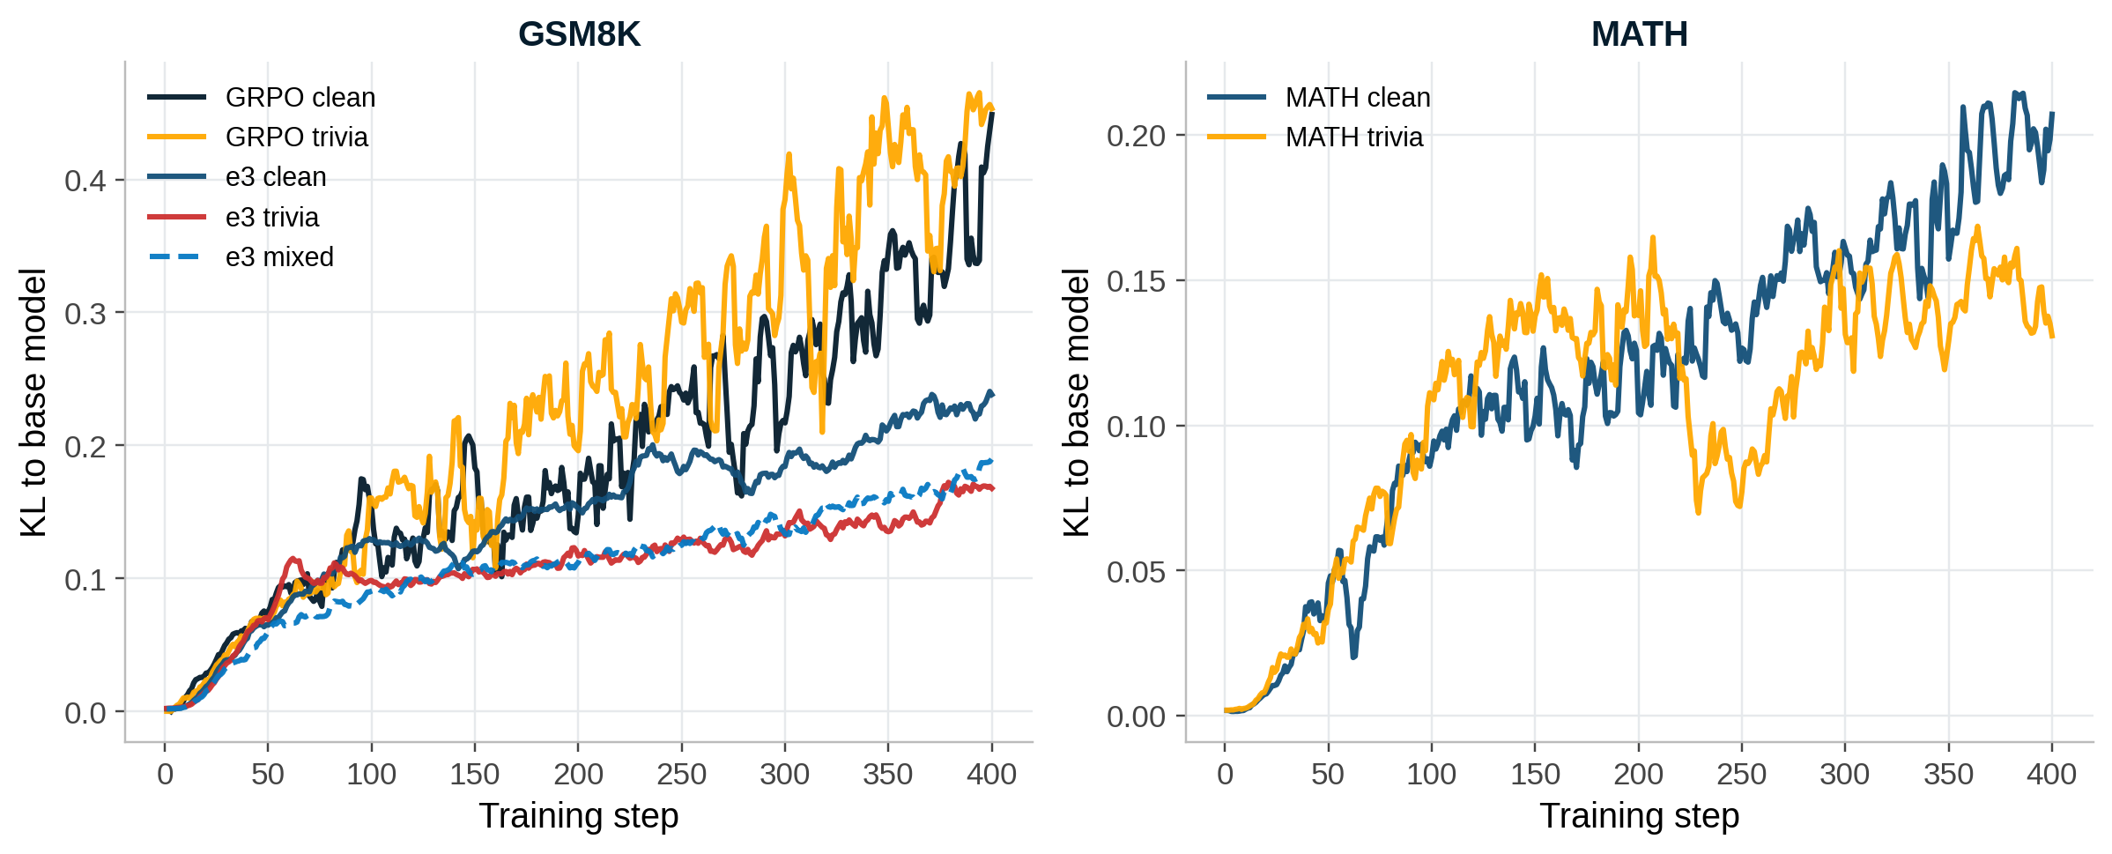
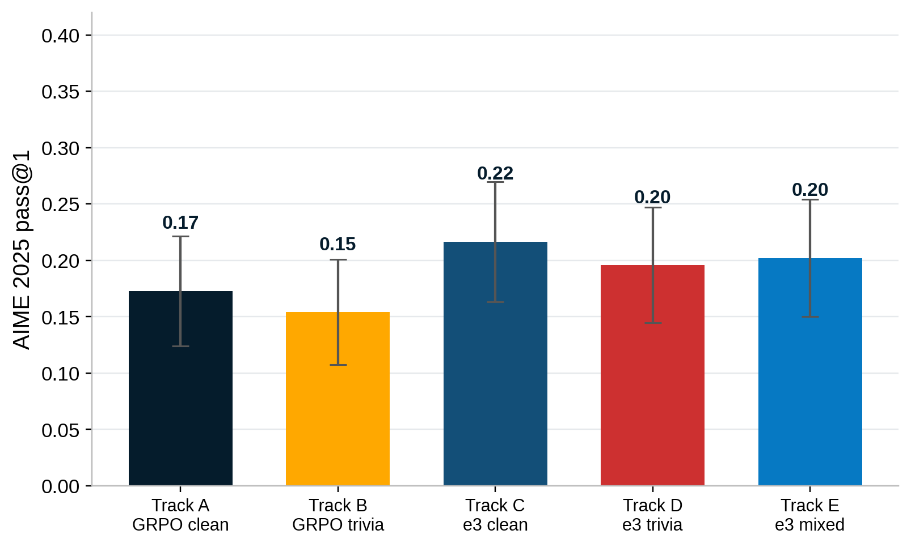
Two opposing knobs — and low drift ≠ better transfer
Two knobs, not one
Divergence from the base model (KL)
Input noise → entropy ▼ sharpen
Negative gradient → entropy ▲ explore
Same word “diversity” — distinct, even opposing, interventions.
The twist Within e3, trivia & mixed stay closest to base. Yet MATH-trivia stayed closest of all and transferred worst (AIME 0.023). Low drift is necessary, not sufficient.
AIME 2025 pass@1 — GSM8K-trained (within noise)
Entropy: trivia pulls it down even on top of e3 (one-line mechanism check).
6

Slide 9
Together, they’re the sweet spot
Content-free input noise is a near-free regulariser
preserves in-distribution accuracy, makes the model leaner (≈45% on MATH), reaches peak on ~half the tokens.
The accuracy lever is the gradient side (e3); trivia’s contribution is efficiency.
Input noise sharpens, negative gradients explore — composable, not redundant.
e3 + trivia = most token-efficient AND closest to base.
Where it goes next
1
Domain (Fibonacci) trivia on MATH
2
More trivia conditions on AIME
3
Scale to o4-mini — RLAD weak-to-strong

Slide 10



“Diversity” names three different machines — they don’t pull the same way
CONTENT
Learned abstractions (RLAD) — adds information to the prompt
DIVERSITY
GRADIENT
Exploration objective (e3) — reshapes the policy update
SAMPLING
More candidates at test time — changes inference, not training
If these aren’t one mechanism, “add diversity” isn’t one prescription.
1

Slide 11



Compute is the new gold — and “diversity” is how RL spends it
THE STAKES
OUR CLAIM, UP FRONT
Diversity is two knobs — not one.
Compute ($ / GPU)
Input noise
sharpens — entropy ↓
Tokens generated
Negative gradient
explores — entropy ↑
Reasoning
RL-for-reasoning explores; exploration is paid for in generated tokens.
Distinct, even opposing — and they compose into the sweet spot.
1

Slide 12

Every “diversity” trick changes two things at once — which one earns the gain?
THE CONTENT
what we add — a hint, an abstraction
Add “diversity” during training
THE PERTURBATION
that we changed the input at all
Is the gain the content of a hint — or just perturbing the input?
1

Slide 13
Introduction: LLMs are surprisingly bad at song parody generation
Song parody entails rewriting a song’s lyrics with a focus on a parody topic while keeping prosody intact, thus, aligning:
Syllables
Stress patterns
Internal rhyme patterns
Reason for LLM failure:
Rhyme requires going past simple token generation, into controlled text generation under prosodic constraints
LLM tokenization and embeddings capture words’ semantic roots and underlying meanings; they do not tokenize or embed words on the level of syllables/phonemes required for rhyme
ChatGPT 5.1, normally fluent, is surprisingly bad at parody generation:
Nice to meet you, where you been? I could show you incredible things Magic, madness, heaven, sin Saw you there and I thought
Hello Paris, phones are ringing, cameras love the rain, Polling’s doing pirouettes inside the fast lane. Elysée hallway, footsteps echo, deals in soft tones— Who wants keys to Matignon and all the unknowns?
Original: ‘Blank Space’ by Taylor Swift
ChatGPT 5.1 result when prompted to create a parody matching rhyme, rhythm and meter on the topic of French politics
Why?
Parody topic adhered to
Syllables too many, line too long
Stress patterns completely different than original
Internal rhyme patterns lost

Slide 14
Related work: a timeline
Introduction: from stochastic parrot to mockingbird
Problem
Riedl generates parody lyrics via GPT-2 plus post-hoc filtering using rhyming dictionaries and hand-crafted English syntax rules
Lack of prosodic constraints
Lack of syllable & phoneme tokenization
2020
Solution
Finetune model– GPT-2 – on dataset of poetry and lyrics
Augment pre-existing dataset with generated data constrained by rhyme and rhythm rules
Aim: yield text that observes prosodic rules without explicit reference
2023
Melody-to-Lyrics models (Tian, Zhao, Chae) that generate lyrics given an input melody or a song form structure
2025
Prompting the mockingbird
Input
Original stanza
Particular theme (e.g., NF, mathematics, Star Wars)
2025
Project Mockingbird

Slide 15
Dataset & data features
To ensure GPT-2 yields text that observes rules on rhythm and rhyme without explicit reference, extensive training is necessary
We trained on 3 datasets
Each line was tokenized with GPT-2’s subword tokenizer for compatibility
Pre-existing Datasets
Gutenberg Poetry Corpus
Aim: Teach our model varied rhythmic patterns through temporal and stylistic diversity
Subset Gutenberg database
120,000 lyrical lines remained post preprocessing
Synthetic data
Aim: Teach our model how (parody) song lyrics look like
122 handpicked stanzas
101 ABBA /ABAB/ AABB stanzas
21 more varied stanzas
(up to) 60 variants
Modern Lyrics Dataset
Aim: Teach our model how song lyrics look like
Contains songs from 21 modern artists (e.g., Taylor Swift, Eminem)
6027 songs
388,712 lines
Already pre-processed
Llama 3.1 8b
230,000 stanzas
Syllable & rhyme filter
50,000 generated stanzas
90/5/5 train/dev/test set split
31 themes

Slide 16
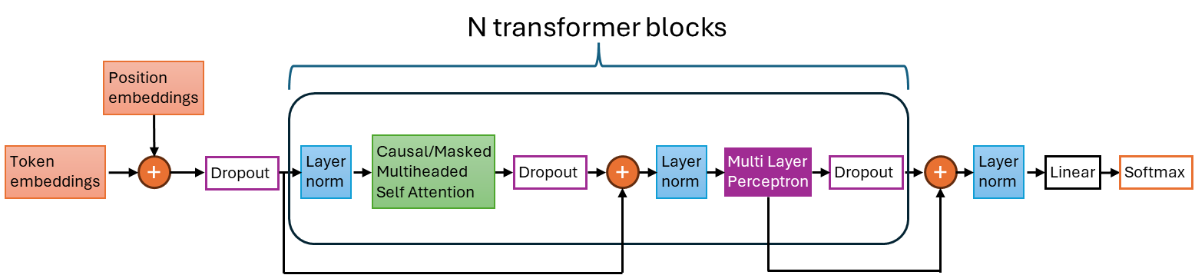
Methodology: from model to evaluation
1
Base model: GPT-2
GPT-2
Selected because of simplicity of fine-tuning and small model size (124M parameters) which enabled rapid experimentation
Model architecture consists of token & positional embeddings, followed by N=12 transformer blocks. It ends with a linear layer & a softmax function
2
Finetuning
Gutenberg Poetry corpus
Modern Lyrics dataset
Synthetic dataset of parody stanzas
Finetuning took place on 3 datasets
3
Syllable matching & Rhyme scheme fidelity
After finetuning, the generated dataset was curated on basis of syllables matching & rhyme
Word-to-phoneme mapping required
Syllable matching; measured as MSE between # syllables in original vs generated line
Rhyme scheme; measured as rhyme presence in candidate stanzas, where the original stanza did
Loss: cross-entropy loss
Training examples already curated per syllable matching & rhyme scheme fidelity
Curation
Synthetic generated dataset
Word-to-phoneme mapping
Syllable matching
Rhyme scheme fidelity
Loss
CMU Pronouncing Dictionary
Mean Squared error
Boolean
Cross-entropy loss
4
Evaluation
Evaluation
Evaluation on syllable matching & rhyme scheme, performed on pairs withheld from training
Stanza – themes pairs withheld from training
Word-to-phoneme mapping
Syllable matching
Rhyme scheme fidelity
Evaluation loss

Slide 17
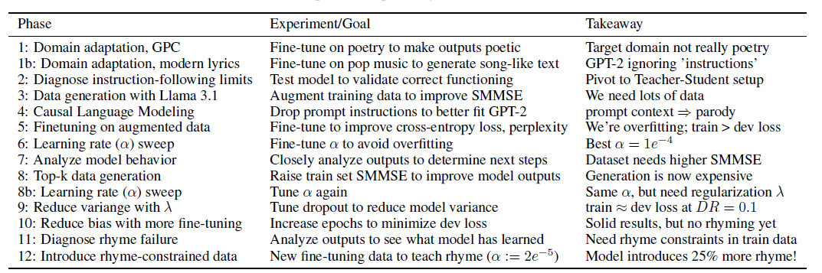
Experiment: from repetition to parody production in 12 phases
Discussion
Metric | Baseline GPT-2 | Initial Fine-tune (end of phase 10) | Final model
Dev Perplexity | >30 | 3.22 | 1.79
SMMSE | >2000 | 9.0 | ∼2.0
RSF | (did not capture) | 44% | 54%
Rhyme Quality | Random prose | Weak/inconsistent | High (Structural matches)
Parody lyric progression
Overview of 12 experimental phases & takeaways
Stage 1b: Lyrics LM (base)
Dance with me, make me sway You are the wind that makes the waves sway Let the waves flow with me Let the waves flow with me...
Steps taken:
Train model on lyric production with Gutenberg corpus & songs
Generate & train on synthetic dataset
To combat high variance, adjust learning rate. Sweep identified 1e−4 as optimal
A dropout sweep (0.1) regularized the model to reduce its variance, and allowed extending training to 6 epochs; resulting dev perplexity 2.64. Despite low perplexity, the model generated semantic parodies but scored 0.00 on structural rhyme accuracy (RSF).
Address data quality issue (inconsistent examples taught that rhyming was optional) by rejection sampling using RSF to create fine-tuning dataset containing only stanzas with verified internal rhymes, resulting in a 25% improvement in RSF
Stage 6: Parody (Underfit, α = 2e−5)
When Pikachu’s numbers start to show Hold me close, show me how Like a goalie’s inflation’s sweet delight Check your stats, don’t be slow
Average Syllable Matching MSE by Model Iteration
Stage 10: Parody (Converged, Epoch 3)
When revving engines start to roar Shift gears tight, let’s speed once more Like a speeding bullet takes to the track Shift gears fast, let’s speed again

Slide 18
Conclusion: Mockingbird’s parody production impresses
Future work: better rhyme, prompting and humour
Criteria
GPT-2 Baseline
Mockingbird
Parody topic Syllables Stress patterns Internal rhyme patterns
None Run-on sentences None None
Can stay on topic Count ~ matches Rhyme pattern appears Still absent
Mockingbird had 54% Rhyme Scheme Fidelity. Improved requires more training data with an ‘easier’ AAAA scheme
Rhyme
In-depth analysis & comments
Increasing computational resources would allow:
Introducing a tokenization that highlights syllables & phonemes, increasing rhyme & syllable awareness
Leaning into continuation-from-context generation
Increased compute
Output progressed from an absence of topic, to more coherent & contextually relevant. However, sometimes it chose another theme than requested
Parody topic
Good parody requires more than rhyme & syllable count; but coherence, and more importantly: humour – a subversion of lyrical expectations, as shown below with ‘quite plain’
Ly-ric
Output evolved from run-on sentences to sentences with clear syllable structure similar to prompt
Humour
As I walk through the valley of the shadow of death I take a look at my life and realize there’s nothing left
Syllables
Coolio, Gangsta’s Paradise
As I walk through the valley where I harvest my grain I take a look at my wife and realize she’s quite plain
Weird Al Yankovic, Amish Paradise
Output went from a lack of rhyme to clear rhyme structure in end-of-line
While staying roughly on topic, our parodies lacked such humour. As a next step, after teaching prosody, we could use humorous text to fine-tune GPT-2.
Rhyme

